Slide 1
Advanced Pacting
Beth Skurrie
@bethesque

Slide 2
Topics
Writing consumer tests
Verifying Pacts
Using tags
CI/CD
Questions

Slide 3
Writing consumer tests
Notes:
This is obviously a huge topic, so I’m going to focus on a few things in particular.

Slide 4
Writing good consumer tests
The key is knowing what *not* to test.
Restraint!
It is easy to write Pact tests that are
Brittle
Overly strict
Burdensome

Slide 5
Writing good Pact tests
is the difference between a
useful Pact implementation
and one which makes everyone wish they’d stuck with integration tests.

Slide 6
What does a good Pact test look like?
There should be sufficient assertions to ensure that the response from the provider will not break the consumer while also keeping:
The scope of the consumer code under test as small as it can be.
The expectations on the response as loose as they can be.
The focus on the messages (request/response), not the implementation.

Slide 7
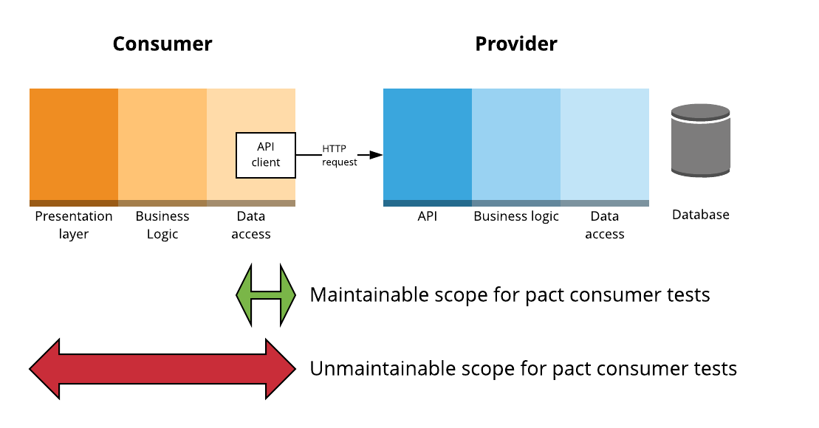
Scope, scope, scope

Slide 8
Why not include the UI/business logic layers?
Maintainability
Using Pact to test UI concerns causes interactions with minor variations to be added to the contact that don’t meaningfully increase test coverage, but do increase the maintenance of the provider verifications.

Slide 9
Provider API Client Responsibilities
Converts back and forth between the business domain classes and concepts of the consumer and the HTTP requests and responses required to communicate with the provider
Abstracts the HTTP-ishness of the provider
Eg. 200 returns an object, 404 returns null, 401 raises a validation error

Slide 10
Options for “top to bottom” consumer tests
Use the pact generated by the unit tests along with a pact stub server.
Use a separate HTTP mock library and use shared fixtures between both the pact tests and the “top to bottom” tests.
Use a separate HTTP mock library and parse the generated pact to initialise the mock.

Slide 11
Pact Matchers - the main ones (v2)
Type based matching
Regular expressions

Slide 12
Type based matching - objects
like(“foo”) - match any string
like(1) - match any number
like(true) - match any boolean
like({
“name”: “foo”,
“address”: {
“street”: “Flinders St”
}
})

Slide 13
Type based matching - arrays
eachLike(“foo”) - an array of strings
eachLike(1) - an array of numbers
eachLike(true) - an array of booleans
eachLike({
“name”: “foo”,
“address”: {
“street”: “Flinders St”
}
})

Slide 14
Type based matching - arrays
eachLike({
“name”: “foo”,
“address”: {
“street”: “Flinders St”
}
}, { “min”: “2} )

Slide 15
Things to remember
Responses can have extra keys without failing the verification, but requests cannot - Postel’s Law.
You can be as strict as you like on requests - they’re your own tests.
V3 matchers https://github.com/pact-foundation/pact-specification/tree/version-3

Slide 17
Functional vs contract tests
Contract tests focus only on the messages (request and response)
When I send
POST /widgets
Request body containing widget properties
I receive
200 OK
Location header with URL of new widget
Response body containing widget properties
Functional tests also check for side effects
All of the above checks
Plus: is the widget stored correctly in the repository?

Slide 18
POP QUIZ
Could you “hardcode” a provider implementation that passes the contract tests, but actually doesn’t persist any data?

Slide 19
POP QUIZ
Could you “hardcode” a provider implementation that passes the contract tests, but actually doesn’t persist any data?
YES!!!!
What stops us doing this?
The functional tests in the provider’s own codebase

Slide 20
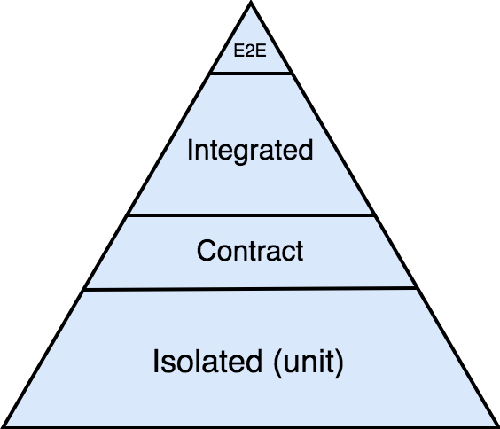
Contract tests aren’t designed to operate alone

Slide 21
It’s not the job of the consumer to be a test harness for the provider
It’s not the job of the consumer to be a test harness for the provider

Slide 22
Is there duplication between functional and contract tests?
Yes, but not entirely
A contract test only covers the attributes of the request and response that a particular consumer cares about
By design it excludes things that the consumer does not care about
Functional test covers all the functionality available to all the consumers

Slide 23
Bad example - functional test
When "creating a user with a username with 21 characters"
POST /users { "username": "thisisalooongusername" }
Then
Expected Response is 400 Bad Request
Expected Response body is { "error": "username cannot be more than 20 characters" }
Focusses on the implementation
Brittle
Tempts you to try and write a test for every scenario

Slide 24
Good example - contract test
When "creating a user with invalid data"
POST /users { "username": "thisisalooongusername" }
Then
Expected Response is 400 Bad Request
Expected Response body is { "error": Pact.like(“some error message”) }
Focuses on the shape of the document
Flexible
Maintainable

Slide 25
Don’t add an assertion for a business rule just because you know it to be true
“All plans IDs for Victoria should start with 8”
“The customer ID should be 12 characters long”

Slide 26
A good contract test aims to expose:
bugs in the consumer code
misunderstanding from the consumer about end-points or payload
breaking changes by the provider on end-points or payload

Slide 27
Other tips
You should be able to construct a proper sentence using the description and the provider state(s).
Given an alligator named Mary exists upon receiving a request to retrieve an alligator by name the provider will respond with …
Think of the readers of the generated documentation and try to use BDD style notation to describe the business actions rather than describing the HTTP mechanisms where possible.
“a request to activate a user” rather than “a request to set active to true”

Slide 28
Other tips
Only use deterministic data - more on this later
Reuse provider states where it makes sense, to ease the maintenance burden on the provider team.
Make your response expectations as loose as possible
eg. {“bar”: Pact.like(“foo”) } rather than {“bar”: “foo”}

Slide 29
Writing consumer tests -
Question time

Slide 30
Verifying pacts
Notes:
This is obviously a huge topic, so I’m going to focus on a few things in particular.

Slide 31
Verifying pacts
Where to stub
Handling authentication and authorization

Slide 32
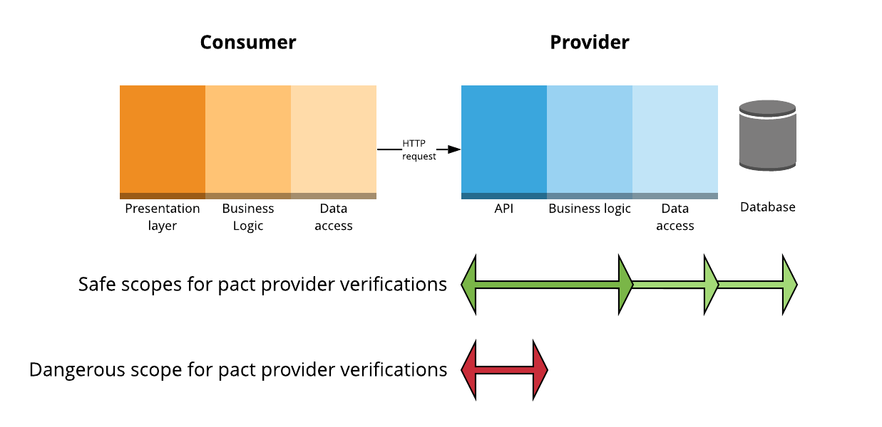
Scope of a provider verification test

Slide 33
Stubbing
Should be able to run on your local development machine
Always stub external services
Stub whichever layer(s) of your provider makes sense for you
Balance
Speed of feedback vs accuracy of feedback
Maintainability of tests
Microservice with SQLite database? Might not need to stub anything
Heavyweight proprietary database? Maybe stub DAO.
Beware of stubbing business logic though
business logic can affect the response given, and hence, make the verification results unreliable

Slide 34
Be aware!!!

Slide 35
When you stub
Be aware of the tradeoffs
Stubbing improves reliability, but reduces confidence
Make sure you have a matching “contract” test with the thing you’re stubbing to make sure you’re stubbing it right.

Slide 36
Handling authentication and authorisation
Should authentication and authorization be part of the contract?
No straight answer, it’s about the tradeoffs
Yes
Increase in certainty
Less to cover in any integrated tests
Good if the auth code is custom and likely to change
No
Simpler
If using stable standards, there may be little benefit
May be more easily covered in e2e tests

Slide 37
Options
Ignore auth (test using other types of tests)
Stub your auth services (client code or implementation)
Use provider states to create real users with matching credentials
Modify the request before sending it using live credentials (using Pact framework)
Make sure the credentials you’re replacing “match”, otherwise, there’s no point in including them in the contract
Use your own custom middleware or proxy to modify the response with live credentials
Use a 100 year token!
Notes:
Once you’re modifying it too much, you need to be sure that there is actually value including the auth in the contract at all.

Slide 38
Required
Communicate
and
collaborate
Notes:
Once you’re modifying it too much, you need to be sure that there is actually value including the auth in the contract at all.

Slide 39
Verifying Pacts - Question time

Slide 40
Pactflow/Pact Broker
Notes:
API documentation
Visualise the relationships between services
View pact diffs
Webhooks

Slide 41
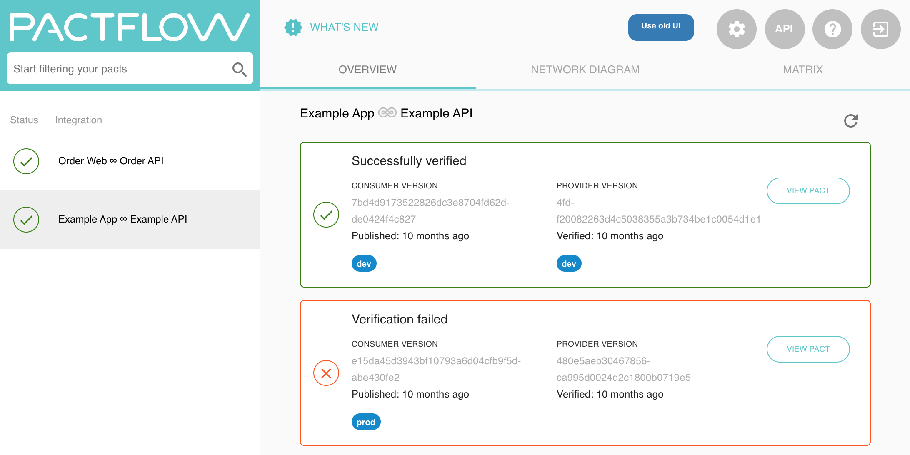

Slide 42
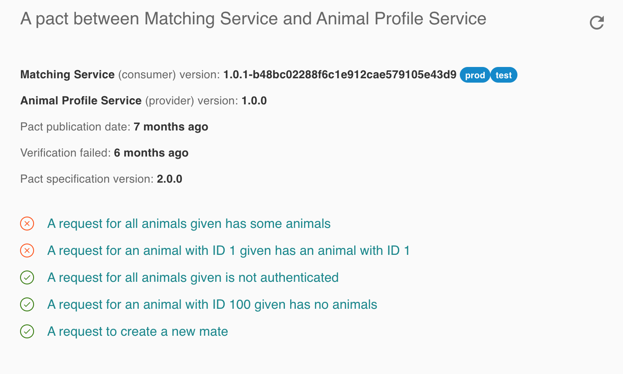

Slide 43
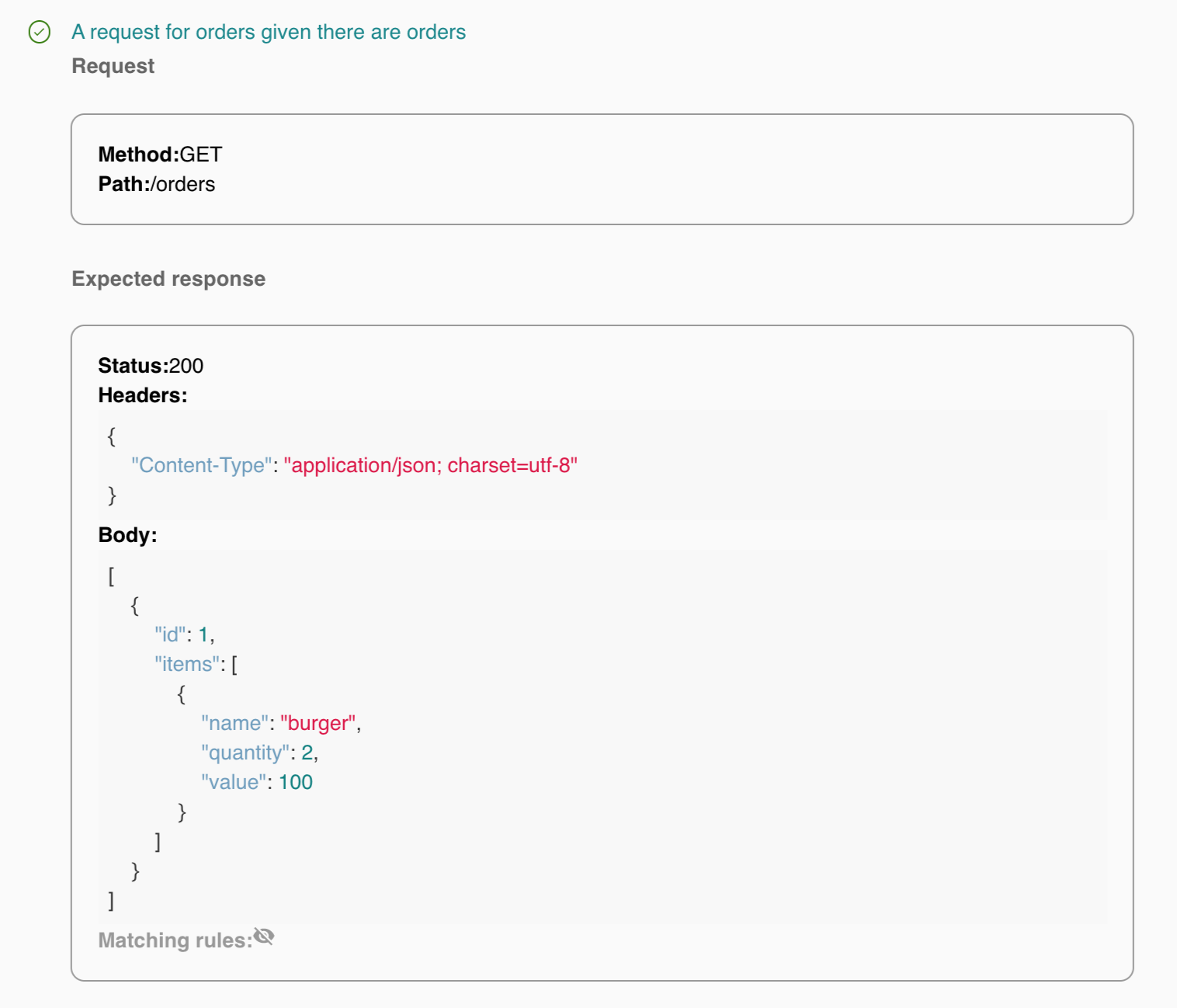

Slide 45
Using tags
Notes:
This is obviously a huge topic, so I’m going to focus on a few things in particular.

Slide 46
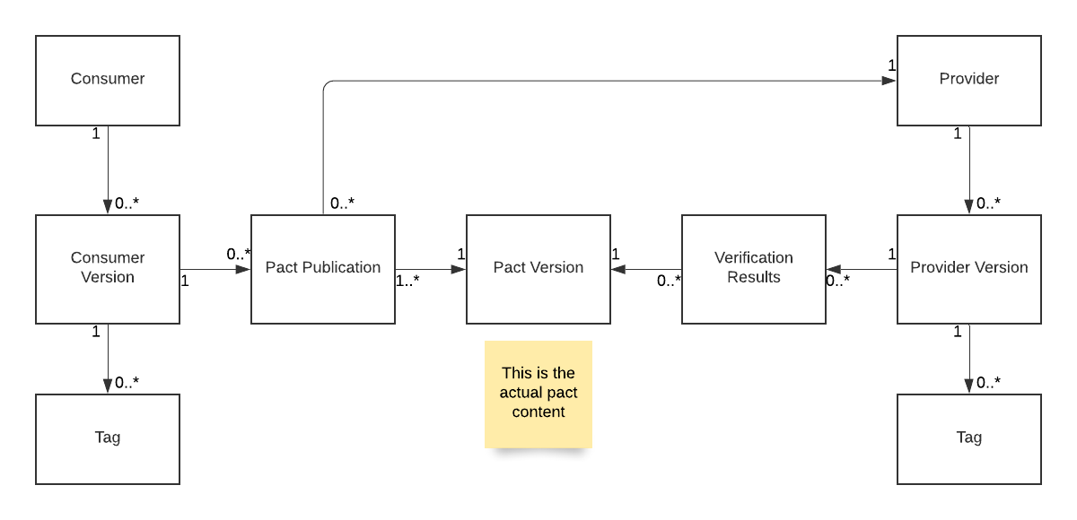
Pact Broker BDM - Pact publication

Slide 47
Pact Broker BDM - with verification results

Slide 48
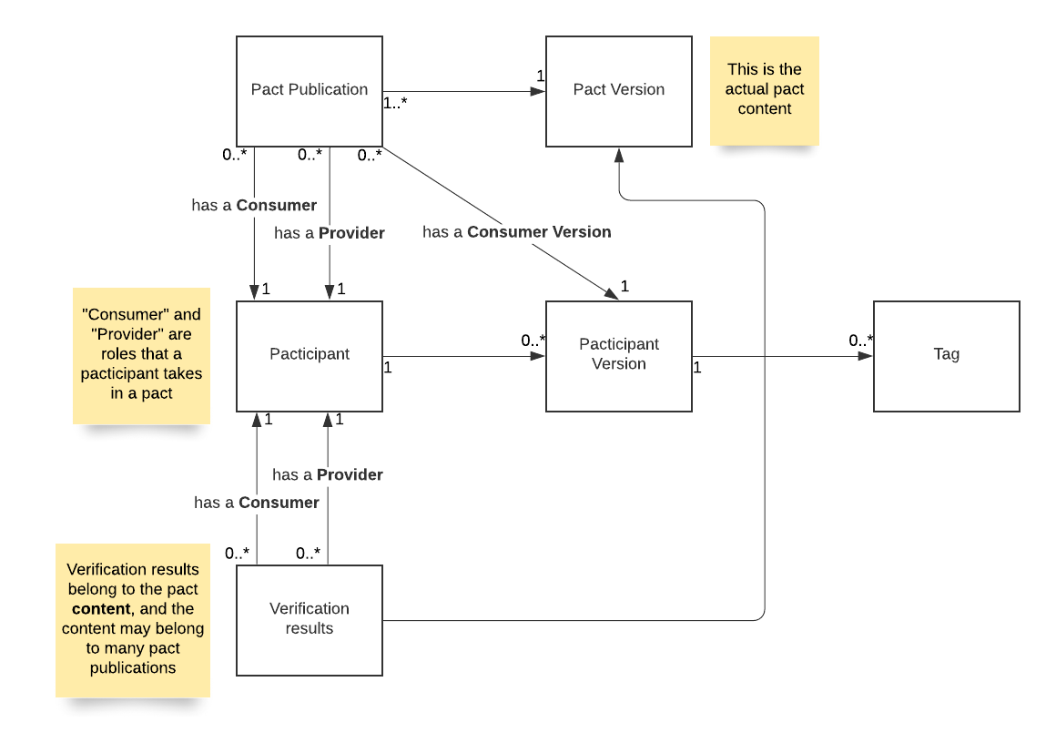
Pact Broker Class diagram

Slide 49
What are tags?
Using Tags
WHAT WE ARE KNOWN FOR
Simple string values
Belong to pacticipant (application) version resources in the Pact Broker
Tell us metadata about the pacticipant version
Git branch eg. “master”, “feat/xyz”
Deployment stage eg. “test”, “prod”
To create:
PUT /pacticipants/PACTICIPANT/versions/VERSION/tags/TAG

Slide 50
When are tags created?
Using Tags
WHAT WE ARE KNOWN FOR
During pact publication - this tells us which branch the pacticipant version (and hence, the pact) was published from
During verification results publication - this tells us which branch the pacticipant version(and hence, the verification results) were published from
After deployment - this tells us which environment the application version is deployed to

Slide 51
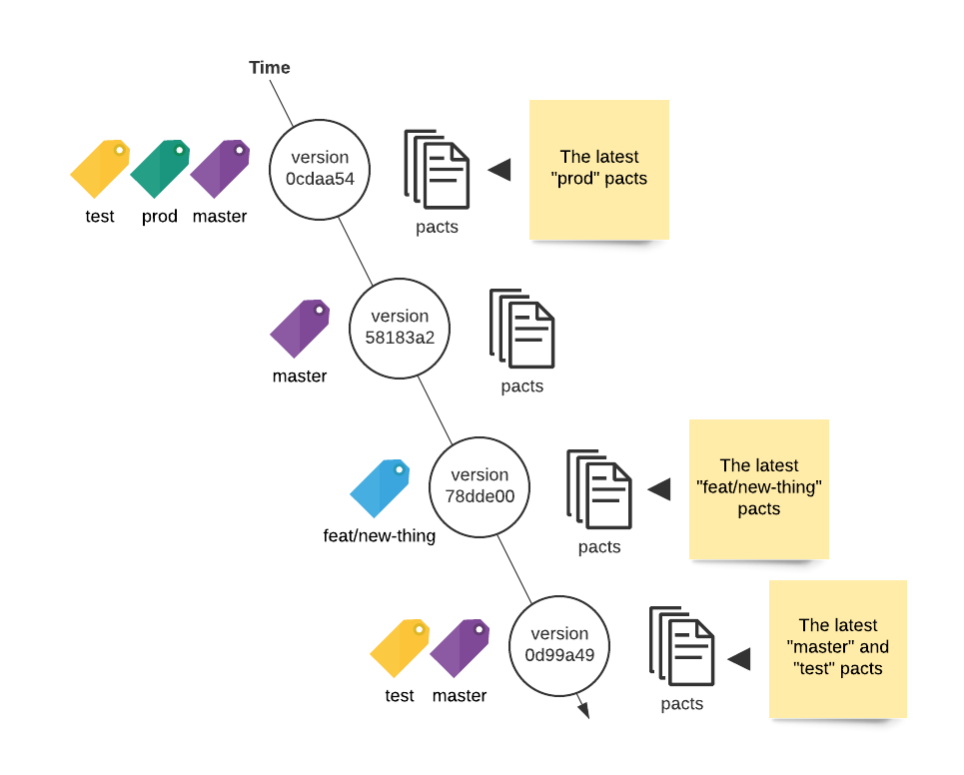
Tagging over time
Using Tags
WHAT WE ARE KNOWN FOR

Slide 52
Things to note
Using Tags
WHAT WE ARE KNOWN FOR
“latest” is not a tag itself (unlike docker tags). It is a dynamically calculated reference to the actual latest resource.
Ordering for calculating the “latest” is done by the creation date of the pacticipant versions, not the tags.
If you rollback to a previous prod version, delete the tag on the undeployed version
You can think of the the time ordered series of pacticipant versions that belong to a particular tag as forming a “pseudo branch”.

Slide 53
What are tags used for?
Identifying the resources in the Pact Broker that belong to a given branch or stage.
Examples
The latest production version of Foo /pacticipants/Foo/latest-version/prod
The pact belonging to the latest production version of Foo, and Bar /pacts/provider/Foo/consumer/Bar/latest/prod
All production versions of a mobile consumer

Slide 54
What does this allow us to do?
Ensure we are verifying the right pacts
Ensure backwards compatibility
Provides a mechanism for introducing changes to pacts
Easily ensure safe deployments

Slide 55
Ensure the right pacts are verified
The example used for default provider verification configurations usually specifies to verify the “overall latest pact”
What if the latest pact came from a feature branch?
Tag with the branch name when you publish pacts
Configure the provider to verify the “latest master” (or whatever the name of your main line of development is).

Slide 56
2. Ensure backwards compatibility
Verifying “latest master” ensures our provider is compatible with the current consumer code.
Microservices -> decouple release cycles of consumer and provider
Need to ensure provider is compatible with production consumer as well as latest
Tag with the stage name when you deploy application
Configure the provider to verify the latest test/prod pacts as well as the latest master.

Slide 57
3. Introduce changes without breaking builds
If following “consumer driven” pacts, pact is changed before provider
This would break provider build
Do changes on branch of consumer, and tag with branch name OR do changes with feature toggle and tag with toggle name
Collaborate with provider team!
Once feature pact is successfully verified, merge to master/turn toggle on

Slide 58
4. Easily ensure safe deployments
Each pact publication is associated with a consumer version
Each pact verification is associated with a provider version
The pact publication is linked to the verification results through the pact (content) version
There is a many to many relationship between consumer version and provider version thought pact publication/pact version/verification results

Slide 59
Quick tangent! Pre-verification
If pact with same content published multiple times with different consumer versions:
New pact publication resource each time
Reuses existing pact version
Inherits existing verification results
This is how pacts are “pre-verified”
This is why it’s best to use deterministic data

Slide 60
The Matrix
Consumer (Foo) version | Provider (Bar) version | Verification result
11 | 54 prod. | success
12 | 54 | failure
12 | 55 | success

Slide 61
The can-i-deploy CLI
Queries the matrix to determine if a set of pacticipant versions can be safely deployed together
ie. is there a pact with a successful verification result between the specified consumer and provider versions

Slide 62
can-i-deploy
Consumer (Foo) version | Provider (Bar) version | Verification result
11 | 54 prod. | success
12 | 54 | failure
12 | 55 | success
$ pact-broker can-i-deploy
--pacticipant Foo --version 11
--pacticipant Bar --version 54

Slide 63
can-i-deploy - better
Consumer (Foo) version | Provider (Bar) version | Verification result
11 | 54 prod. | success
12 | 54 | failure
12 | 55 | success
$ pact-broker can-i-deploy
--pacticipant Foo --version 11
--pacticipant Bar --latest prod

Slide 64
can-i-deploy - best
Consumer (Foo) version | Provider (Bar) version | Verification result
11 | 54 prod. | success
12 | 54 | failure
12 | 55 | success
$ pact-broker can-i-deploy
--pacticipant Foo --version 11
--to prod

Slide 65
Tagging with feature toggles
The current Pact Broker workflow best suits branch based development
Expects one pact per consumer version, but feature toggles mean there might be multiple variations of the pact for the same git sha.
Conceptually though, these can be thought of as different versions

Slide 66
Potential feature toggle hack
Consumer
Create pact with toggles off
Consumer version - sha eg. effe8a07
Tag with ‘base’
Create pact with toggle A on
Consumer version sha+toggle_name eg. effe8a07+feat_a
Tag with toggle name
Provider
Verify pacts with toggles off
Provider version - sha eg. d3092627
Tag with ‘base’
Verify pacts with toggle B on
Provider version - sha+toggle_name eg. d3092627+feat_b

Slide 67
CI/CD
Notes:
This is obviously a huge topic, so I’m going to focus on a few things in particular.

Slide 68
The CI/CD/Pact Broker touchpoints
Pact changed (CI)
Provider changed (CI)
Release workflow (CD)

Slide 69
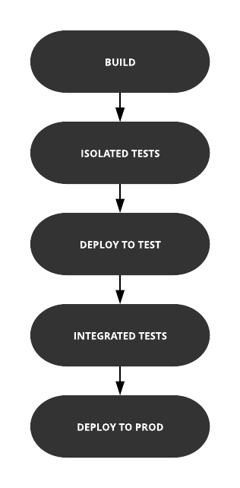
Build pipeline without Pact

Slide 70
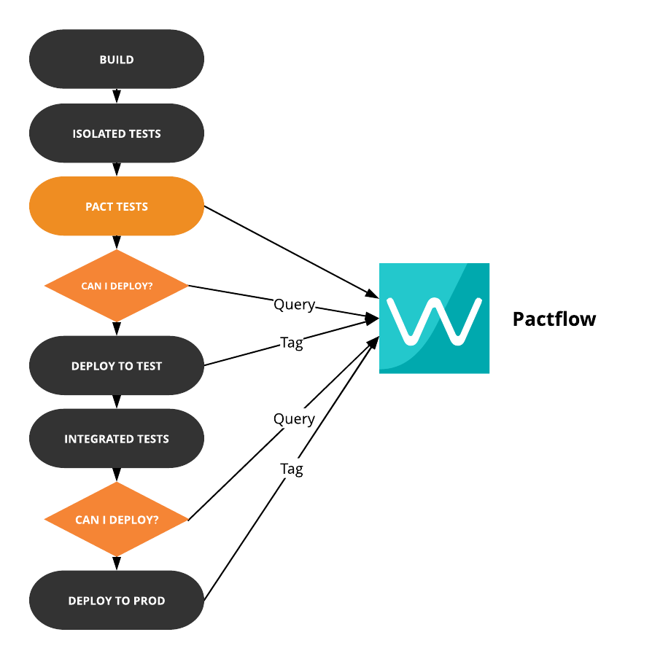
Build pipeline with Pact

Slide 71
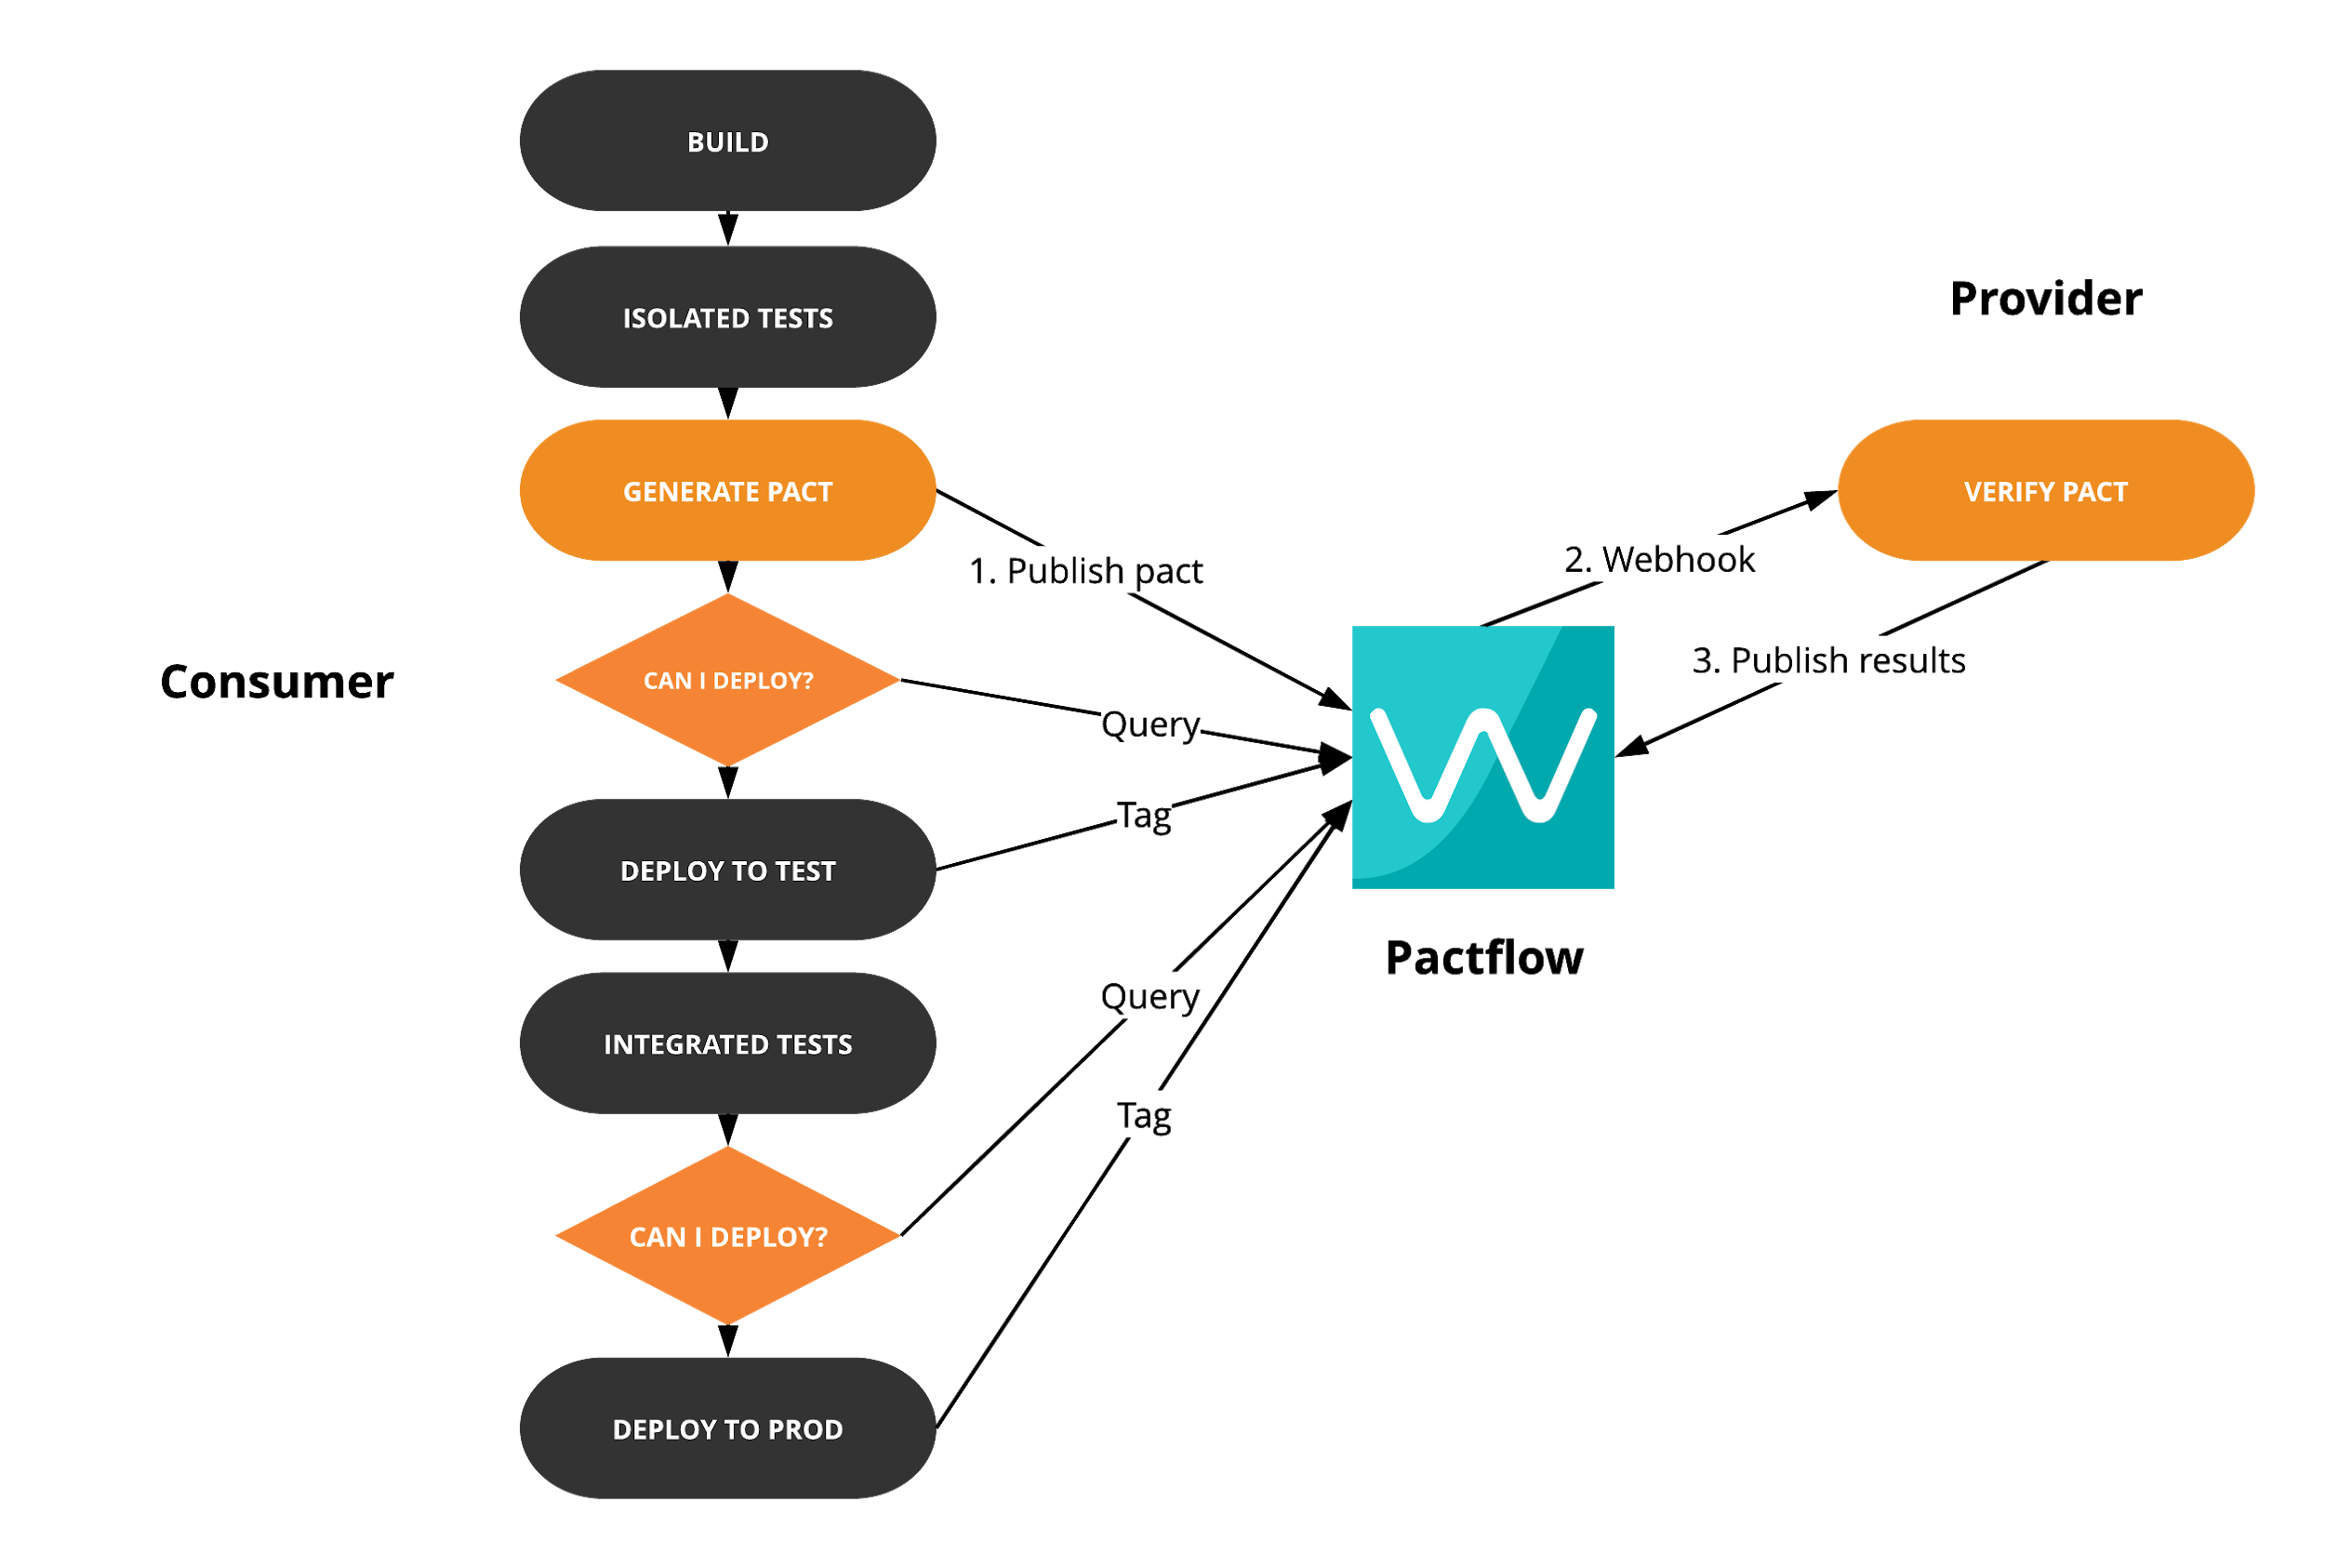
Build pipeline with Pact - Consumer
Notes:
You might be thinking, will can-i-deploy break my master build?
Not if you’ve followed the recommendation of doing changes on a feature tag
By the time the consumer code gets to main line of development, it should already be pre-verified by the provider’s main line of development

Slide 72
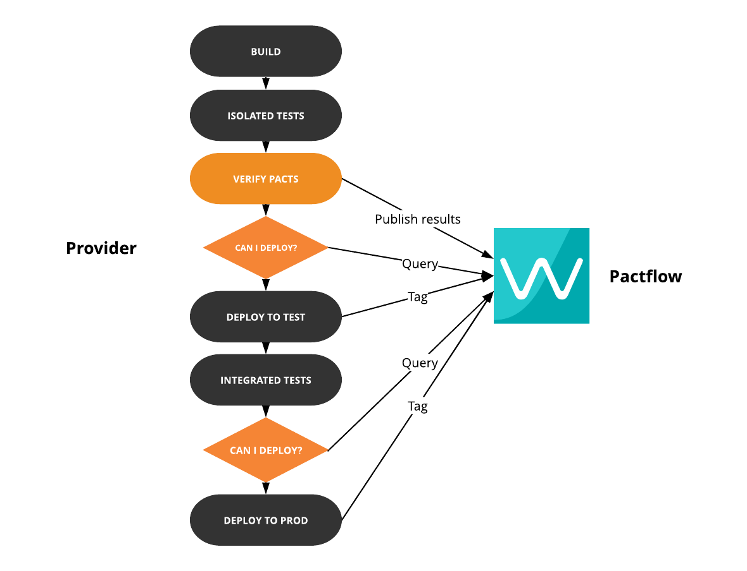
Build pipeline with Pact - Provider

Slide 73
For extra brownie points
Git statuses
Slack updates

Slide 74
CI/CD - Question Time

Slide 75
Pending pacts - the problem
Changes to the pact can break the provider’s build

Slide 76
Pending pacts - the solution
If the pact content has not yet been successfully verified:
It is considered “pending”
If verification fails, it will not fail the build
Once it has been successfully verified:
It is no longer “pending”
Any failure can only be due to a change in the provider
If verification fails, it will fail the build

Slide 77
Pending pacts - something to note
The pending status is calculated based on the tags that will be applied to the provider version when the results are published

Slide 78
WIP Pacts - the problem
Changed pact published with tag ‘feat/foo’
‘Changed contract’ webhook triggers verification - failure
Provider implements required changes
Provider runs verification for consumer tags ‘master’ and ‘prod’
Unless provider team changes the consumer tags to verify in the configuration, the ‘feat/foo’ pact won’t get a successful verification result.

Slide 79
WIP Pacts - the solution
Changed pact published with tag ‘feat/foo’
‘Changed contract’ webhook triggers verification - failure
Provider implements required changes
Provider runs verification for consumer tags ‘master’ and ‘prod’ - and also automatically verifies any “work in progress” pacts.
A “work in progress” pact is one which is the latest for its tag, and has not yet been successfully verified.

